Slide 1

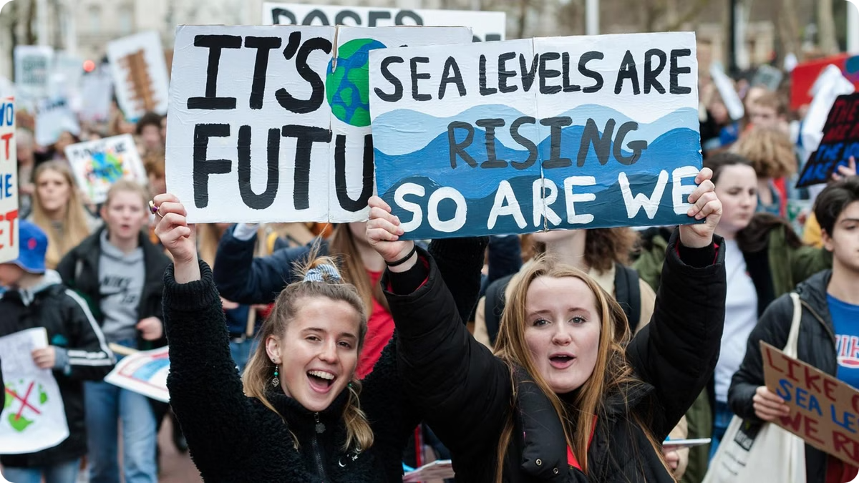
Educating High School Students about the SDGs
This lesson plan aims to integrate the Sustainable Development Goals (SDGs) into high school science curriculam, empowering students to become informed global citizens and active participants in shaping a sustainable future.
TEAM DETAILS :
TEAM NAME – TECH BIOBOTS
TEAM LEADER NAME – ADITYA BHATT
PROBLEM STATEMENT – SDGS IN THE CLASSROOM

Slide 2

Integrating Sustainable Development into youth.
Science Concepts
Interdisciplinary Learning
Real-World Applications
Connecting SDGs to existing science units like ecology, energy, or climate change.
Encouraging collaboration between science, social studies, and humanities teachers.
Showcasing how scientific knowledge can address global challenges.

Slide 3

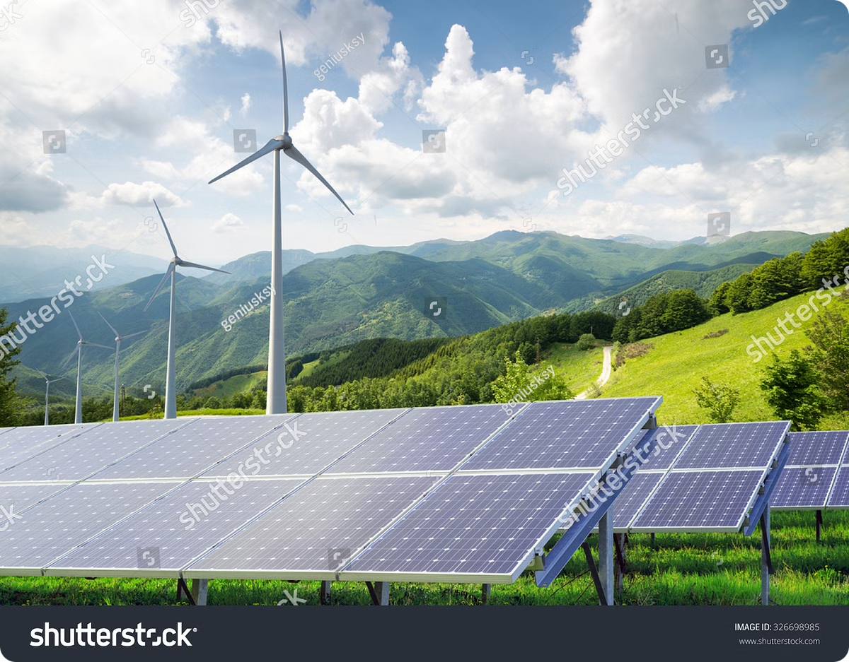
Brief about the idea.
1
The brief about our idea is we are creating a web-application for youth , for better understanding of SDG's.
2
To integrate data as a lesson plan on a single website for youth which can be easily accessible.
3
Simplifies complex information into a simpler form for youth.

Slide 4
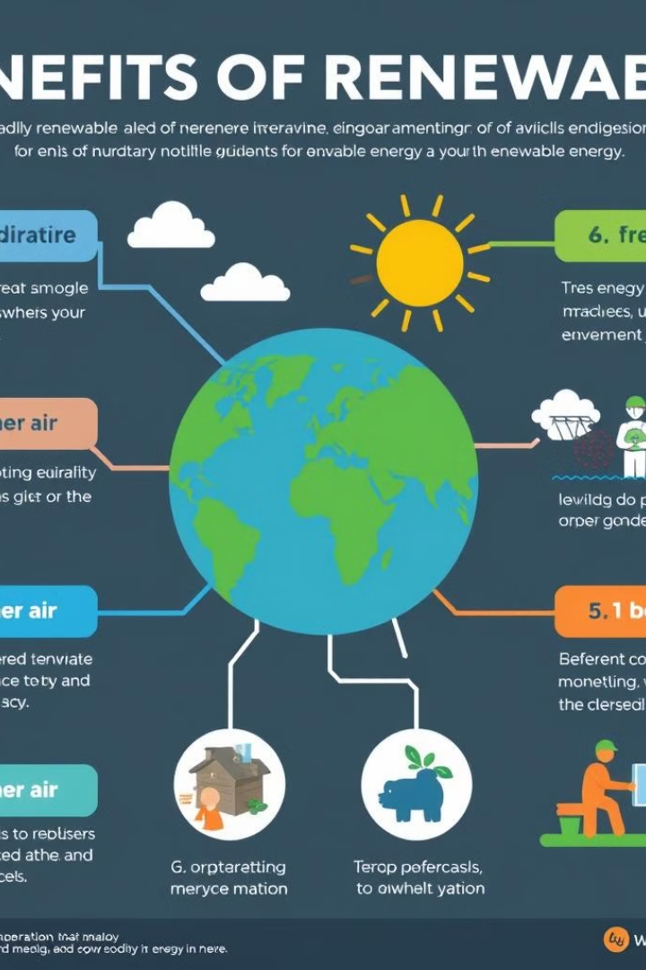
Key features of application.
Enhanced and user friendly lesson plan for the youth . Providing solutions for various problems .
Unlike Generic applications it provides the data to people in more efficient way.
Energy Empowering students and public with new technologies and embracing with new information .

Slide 5
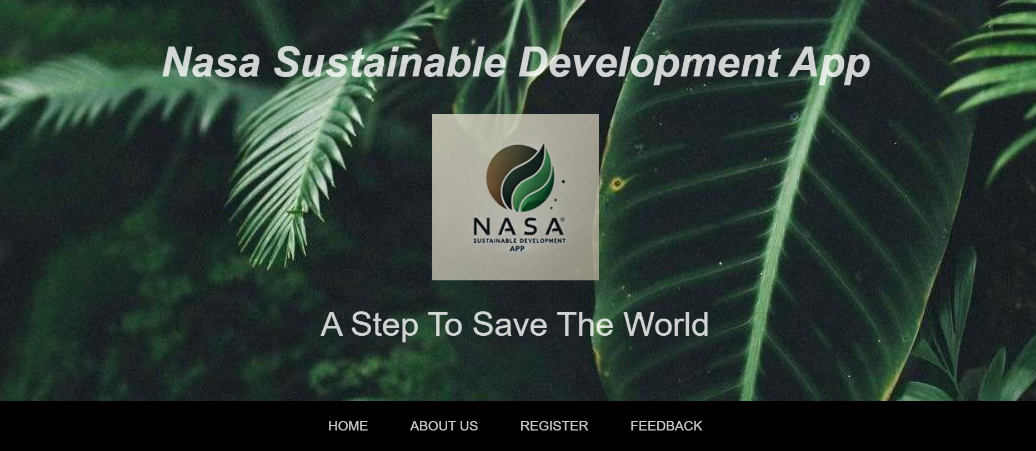
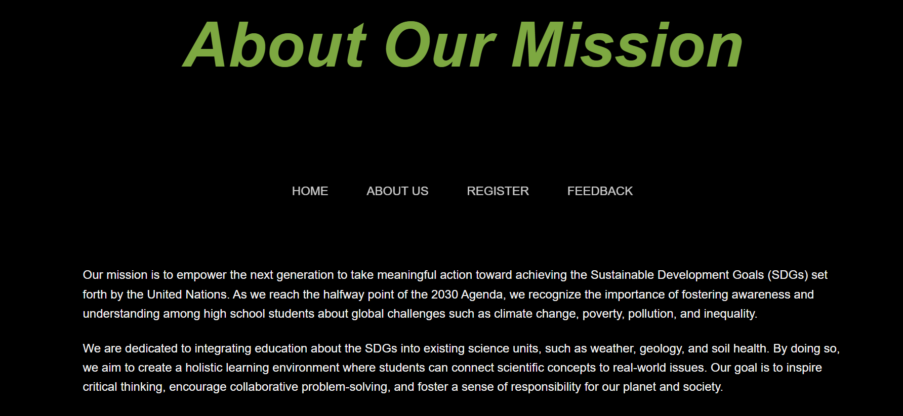
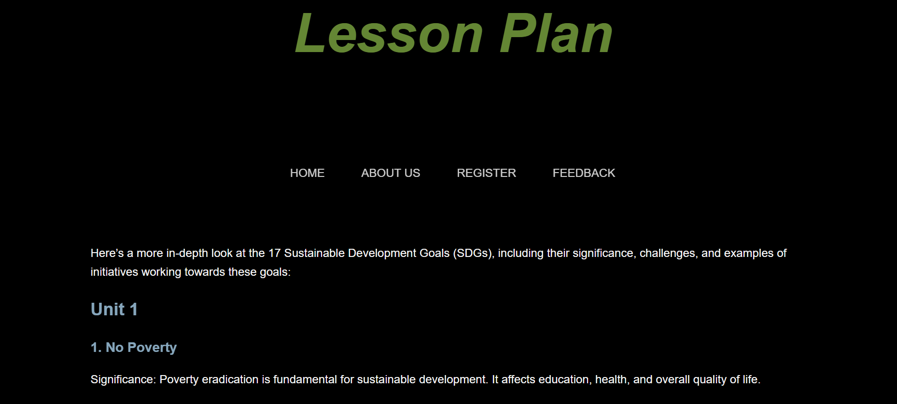
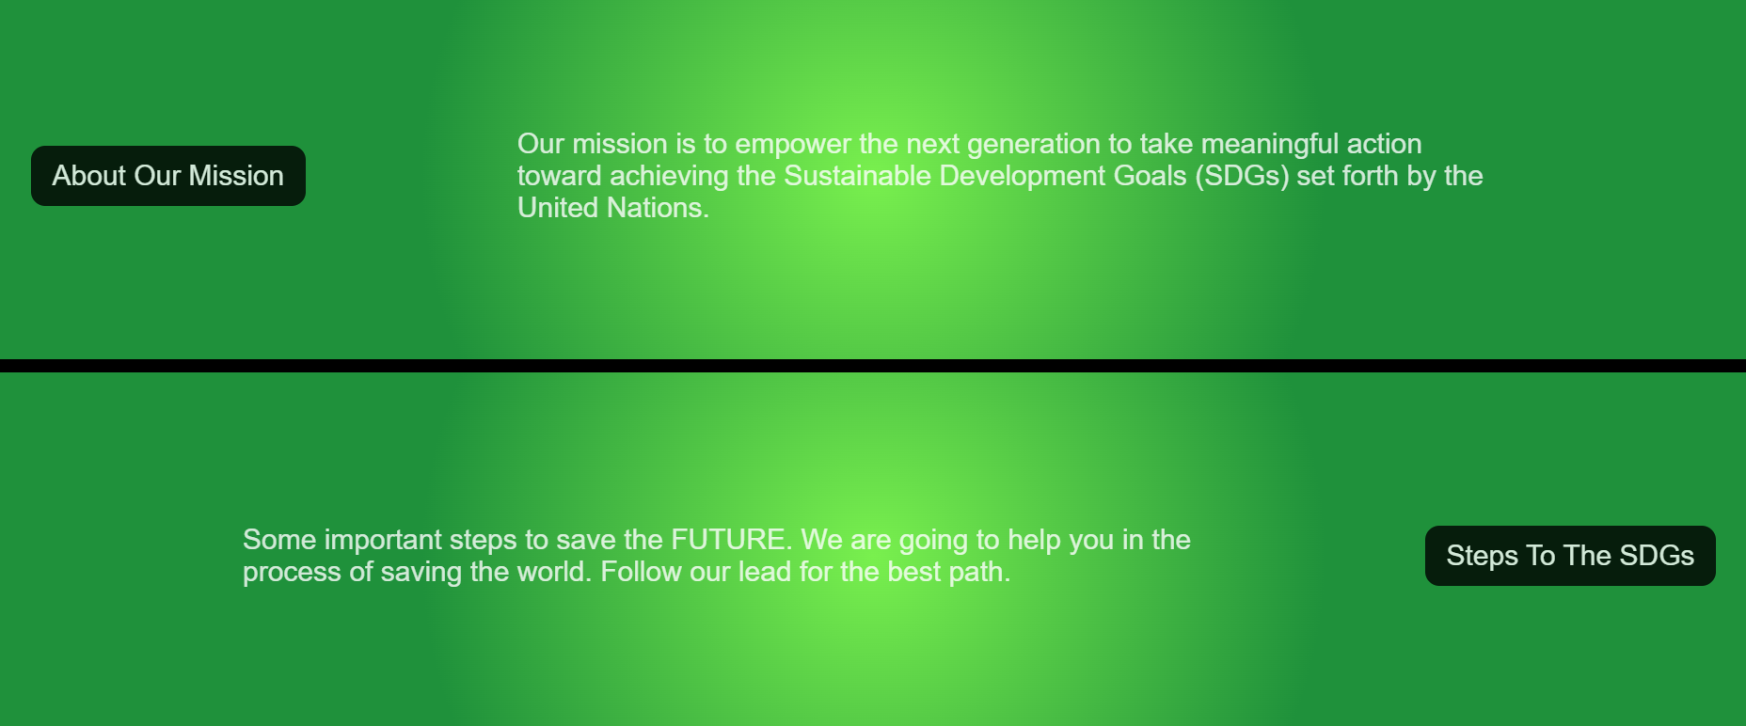
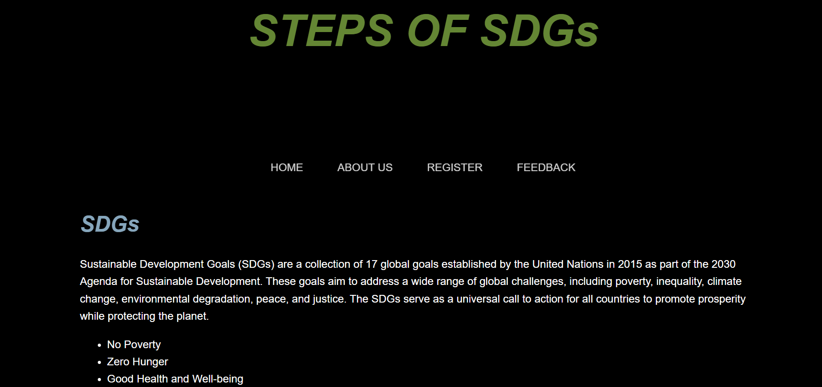
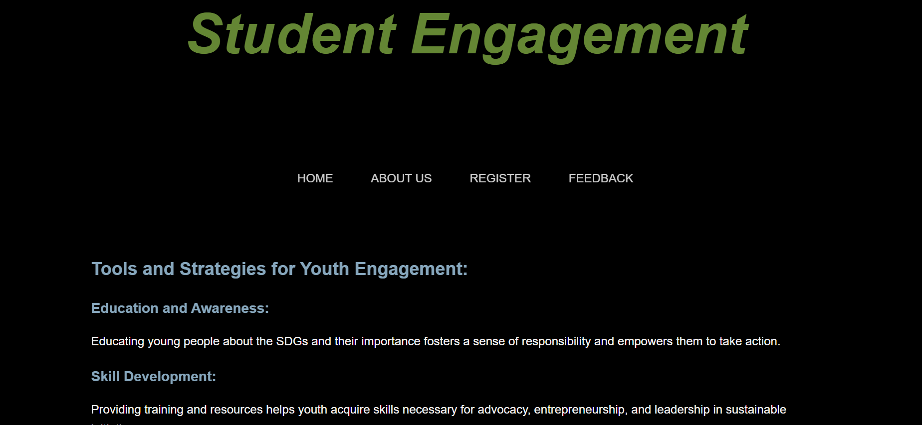
SNAPSHOTS:

Slide 6
Key technologies used:
Front end :
Html : For making skeleton of websites.
Css : For styling the website.
Java Script : For giving specific positions.
Back end :
Python : Handle large datasets generated .
Data management :
My Sql : For handling unstructured user data.

Slide 7
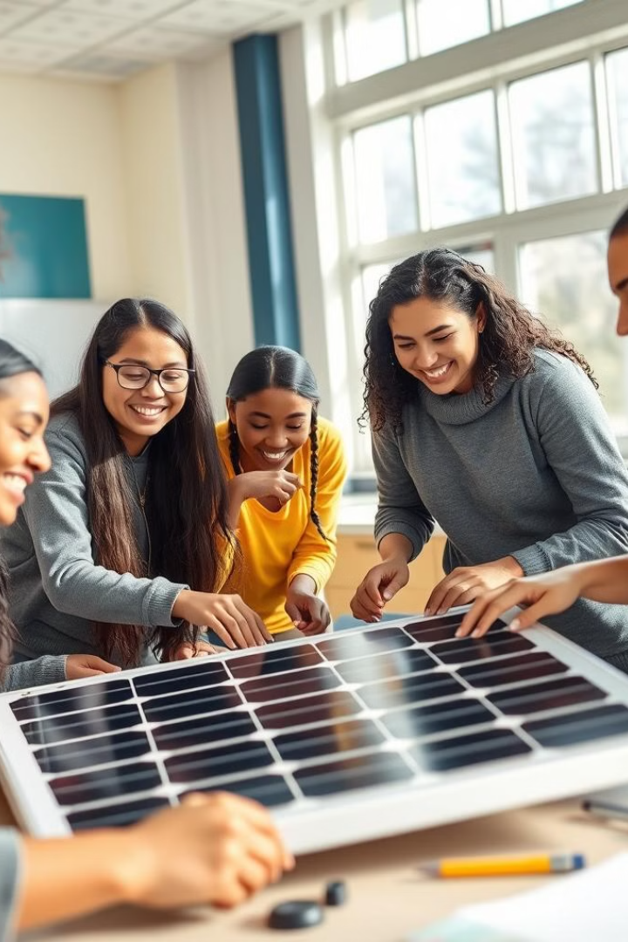
Bringing the SDGs to Life in the Classroom
1
Explore
Introduce students to the SDGs, their importance, and their interconnectedness.
2
Investigate
Deepen their understanding of SDG #7, focusing on renewable energy and its implications.
3
Collaborate
Encourage teamwork, critical thinking, and communication skills through hands-on activities.
4
Act
Empower students to become advocates for sustainable development and take action in their communities.

